Slide 1
Develop web application for interactive visualization of gas turbine data using Plotly Dash
Hack O’ Holics
DU1301
haQathon 2020
Global Product Engineering and Lifecycle Services Company
Notes:
Talking points:
We have built QuEST over the last 21 years as a aspiration driven organization. We continue to push the boundaries, create new frontiers across multiple safety critical and hi-tech industries we serve. We do this by offering our Customers a range of Services and Solutions and engagement models that spans – Engineering, Enterprise solutions, Operations, Supply Chain and Technology enabled solutions covering the complete product lifecycle.
As such, QuEST is a Leading Global Product Engineering and Lifecycle Services Company
In this presentation we will cover 3 aspects of QuEST.
WHO we are, WHAT we do and for WHOM, and why we are in business – our purpose
Then we move on to HOW we engage with Customers
Finally we will cover HOW we are different and can add unique value to you and help you “Create the Frontier”

Slide 2
Develop web application for interactive visualization of Gas turbine data using Plotly Dash
Hack O’ Holics
Mentor | : | Mr. Basha Peer Mahaboob
Ideator | : | Bhagirathi Behera
Team Lead | : | Bhagirathi Behera
Team Members | : | Bhagirathi Behera Kiran Ahuja Mokshavi Ummadisetti Savita Patil
Notes:
Idea/Solution/Prototype: Give a one-liner about the solution for the given problem statement
Team Name: Add team name to the entry field
Mentor Name: Add mentor’s name to the entry field
Ideator Name: Add ideator’s name to the entry field
Team Lead Name: Add team lead’s name to the entry field
Team Members Name: Add team member’s name to the entry fields one after another

Slide 3
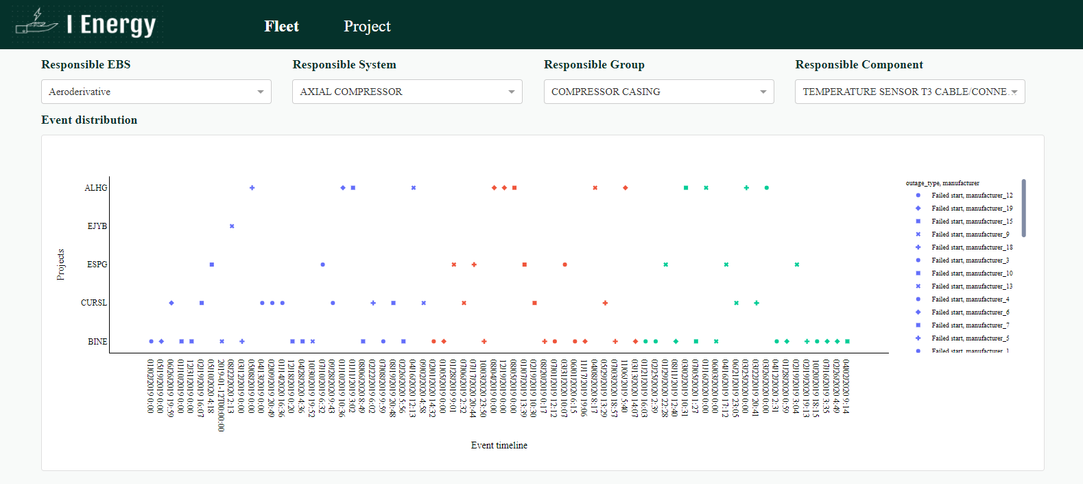
Scope
Problem Statement
Approach
Outcome
Power generation sector needs a continuous improvement in technology and procedure to fulfil power requirements and compete in market. To understand the trends and compare the performance one must visualize the data generated from the units. Most of the times it is time consuming. Different people may use different tools, which makes the output non standardize.
Create database in PostgreSQL from gas turbine data and connect database to dashboard.
Understand the relation. between data to get meaningful visualization.
Data cleaning and handling special cases.
Develop UI for dashboard layout using dash core components, dash html components and dash bootstrap components.
Create call-backs for interactive visualization.
A web application, which provides a dashboard for visualization. It gives various options to select different sites, technology, equipment, components, analysis type, time frame etc. Once data is selected, the output is very much interactive for better understanding.
Technology stack: Dash, Plotly, python, pandas, flask, bootstrap4, PostgreSQL
Notes:
Problem Statement: Illustrate the basic problem along with technologies used
Approach: Methods planned to solve the target problem in order to attain a viable solution within the constrained time of 2 days of hackathon
Outcome: Results obtained as part of development towards the end of hackathon to be demonstrated with the help of table, diagram if any

Slide 4
Technology Choices
Sl. No. | Technologies used | Rationale for selection
1 | Dash | Framework to create data visualization dashboard with python
2 | python | Backend code and business logic
3 | Plotly | Create plots
4 | pandas | Data manipulation
5 | bootstrap4 | Page styling
6 | PostgreSQL | Effective database management
Notes:
Technology Choice: Add technologies used and rationale for selecting so

Slide 5
Business Case
Product Deployment
Value Added to QuEST / Customer
It can be easily deployed in various cloud platforms.
It can be used as a part of another application.
In Oil and Gas, Renewable vertical’s customer need to visualize data in order to monitor and to solve onsite issues, to find drawbacks and improvement scopes. With the help of dash, we can build customized data visualization web app very fast.
Web applications can we developed without the knowledge of front-end languages and frameworks.
Notes:
Product Deployment: How the Solution Can be Deployed? -- Target Environment, What is needed, etc.
Value Added to QuEST: Business Benefits? -- How QuEST can benefit; be specific about customer, VBU etc.

Slide 6
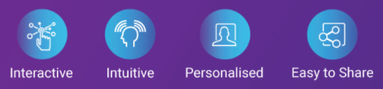
Learning Points
Key Learning
Scope for Improvement
It is increasingly valuable for professionals to be able to use data to make decisions and use visuals to tell stories of when data informs the who, what, when, where, and how.
Data visualizations make big and small data easier for the human brain to understand
It can be used in power generation industry for data analysis and monitoring.
It can be further extended for live data visualization, alert.
It can be improved to generate customize reports.
Features can be added
Export data from graph and table.
Option to swap axis and change axis range.
Option to change visualization type for same input.
Notes:
Key Learning: Team Experience, Bottle necks, “Aha” Moments, etc.
Scope for Improvement: How the solution can be improved further?

Slide 7
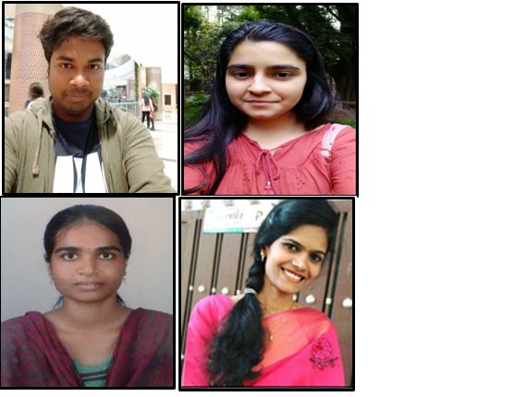
The Experience
The Team
"Life is the process of learning new things" HaQathon made us to go through some new technologies and innovations We are pleased to participate in annual technical festival HaQathon 2020 despite of all our busy working hours. Looking at new interesting real time problems and providing the solutions.
Notes:
THE EXPERIENCE: Add one liner by team member(s) as well as mentor about their overall hackathon experience. Teams may mention about learning something new, meeting new people, explain the process of building stuff, testing and validating their technical skills, etc. Mentor may talk about working with the team and their achievement at the hackathon.
PHOTO: Add picture of the team along with their developed prototype

Slide 8
Thank You
Engineering | Enterprise Solutions | Operations & Supply Chain | Technology & Digital Solutions

